Slide 1

Interfacing of Bbb wireless with thinkspeak cloud
Submitted by
Amit kumar
9.24.XX

Slide 2

What is iot?
The Internet of things (IoT) describes the network of physical objects—“things”—that are embedded with sensors, software, and other technologies for the purpose of connecting and exchanging data with other devices and systems over the Internet.

Slide 3

Key Benefits of IoT Platforms Software
Design and execute complex IoT projects using internal resources
Establish communication protocols for connected hardware
Determine which data will be collected by sensors and which actions will be carried out by IoT devices
Integrate business systems and software with connected assets to allow the smooth, continuous flow of data

Slide 4
List of IOT services provider
ThingSpeak - By Mathworks,Inc
Amazon web services - Amazon
Twilio - Twilio
Upswift - Upswift, Inc
ARTIK - Samsung Electronics co.
JASPER - Jasper Technologies, Inc.
ThingWorx - PTC, Inc
Etc..

Slide 5
What is ThinGSpeak?
ThingSpeak is an open-source Internet of Things (IoT) application and API to store and retrieve data from things using the HTTP and MQTT protocol over the Internet or via a Local Area Network.
ThingSpeak has integrated support from the numerical computing software MATLAB from MathWorks,[4] allowing ThingSpeak users to analyze and visualize uploaded data using Matlab without requiring the purchase of a Matlab license from Mathworks.

Slide 6
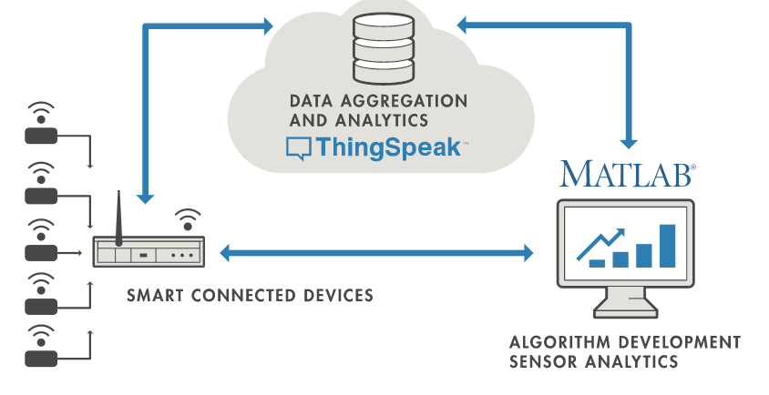

Slide 7
WHat is Http?
The Hypertext Transfer Protocol (HTTP) is an application layer protocol for distributed, collaborative, hypermedia information systems. HTTP is the foundation of data communication for the World Wide Web, where hypertext documents include hyperlinks to other resources that the user can easily access, for example by a mouse click or by tapping the screen in a web browser.
HTTP functions as a request–response protocol in the client–server computing model. A web browser, for example, may be the client and an application running on a computer hosting a website may be the server. The client submits an HTTP request message to the server. The server, which provides resources such as HTML files and other content, or performs other functions on behalf of the client, returns a response message to the client. The response contains completion status information about the request and may also contain requested content in its message body

Slide 8
What is Mqtt?
MQTT (Message Queuing Telemetry Transport) is an open OASIS and ISO standard (ISO/IEC 20922) lightweight, publish-subscribe network protocol that transports messages between devices. The protocol usually runs over TCP/IP; however, any network protocol that provides ordered, lossless, bi-directional connections can support MQTT. It is designed for connections with remote locations where a "small code footprint" is required or the network bandwidth is limited.
The MQTT protocol defines two types of network entities: a message broker and a number of clients. An MQTT broker is a server that receives all messages from the clients and then routes the messages to the appropriate destination clients. An MQTT client is any device (from a micro controller up to a fully-fledged server) that runs an MQTT library and connects to an MQTT broker over a network

Slide 9
Components of Channel on Thingspeak
Number of Fields (8 ) on any channel on free version of thingSpeak.
Longitude and Latitude
Github link
Video URL
External Site

Slide 10
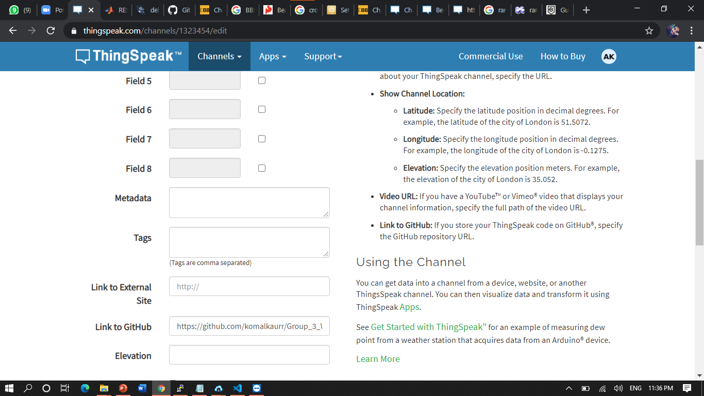

Slide 11
Features of Channel
MATLAB Visualition and Analysis
Private View and Public View
Export and Import Data
API keys (read and write API keys)

Slide 12
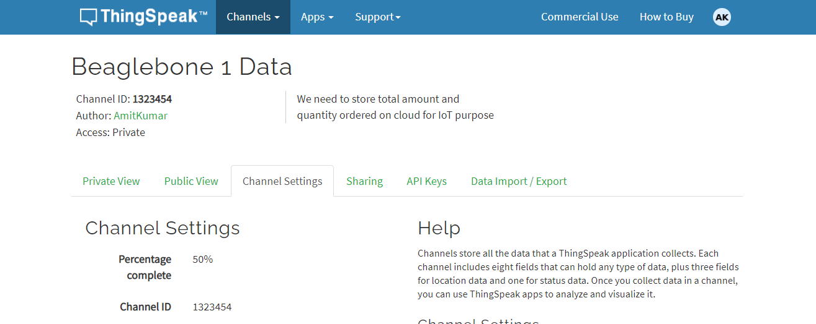

Slide 13
Uses of api Keys
Types of API keys
Read API key
Write API key
User API key
Read and Write API keys are only used for reading and writing data in our channel.
User API key is used for our account purpose .

Slide 14
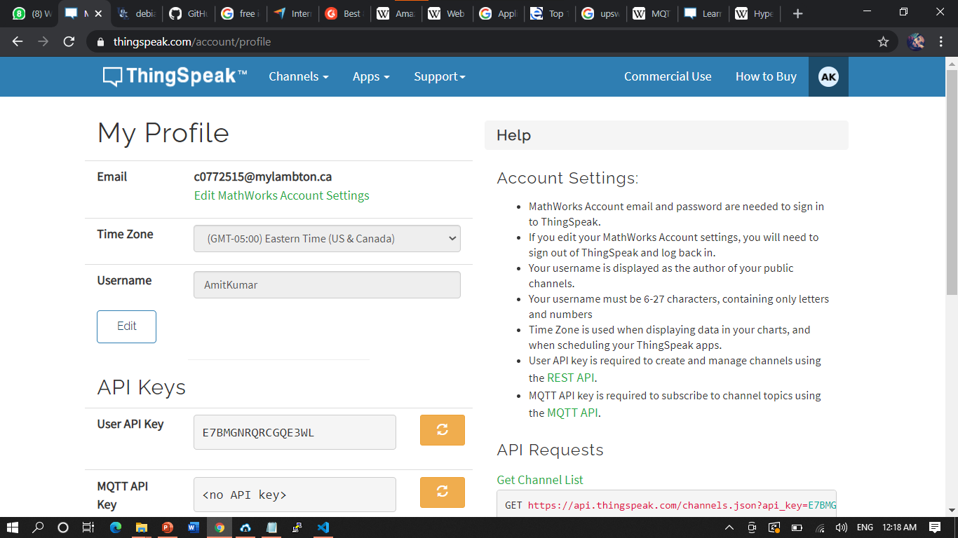

Slide 15
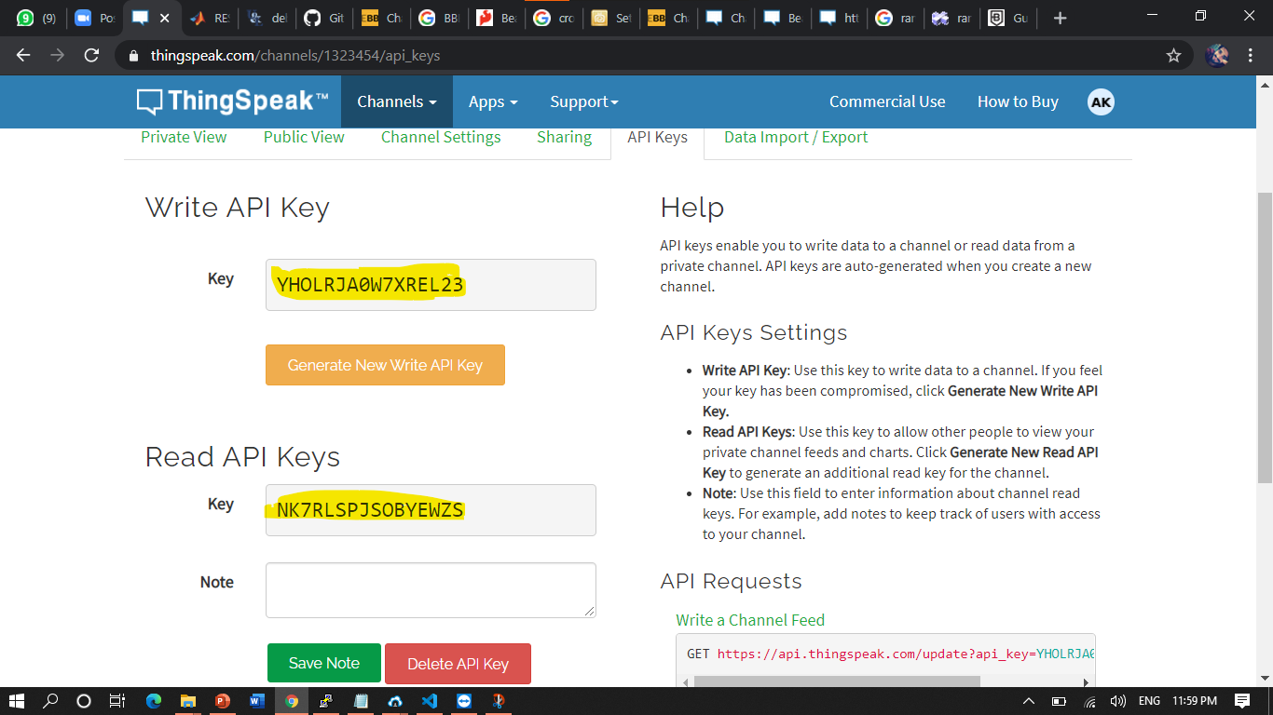

Slide 16
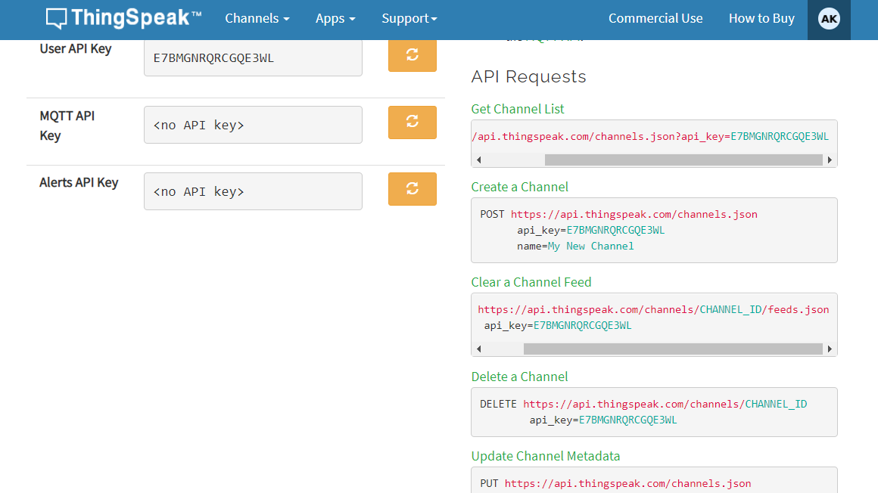

Slide 17

Apps features of thingspeak
MATLAB analysis
MATLAB visualization
React
Talkback
ThingTweet
TimeControl
ThingHTTP

Slide 18
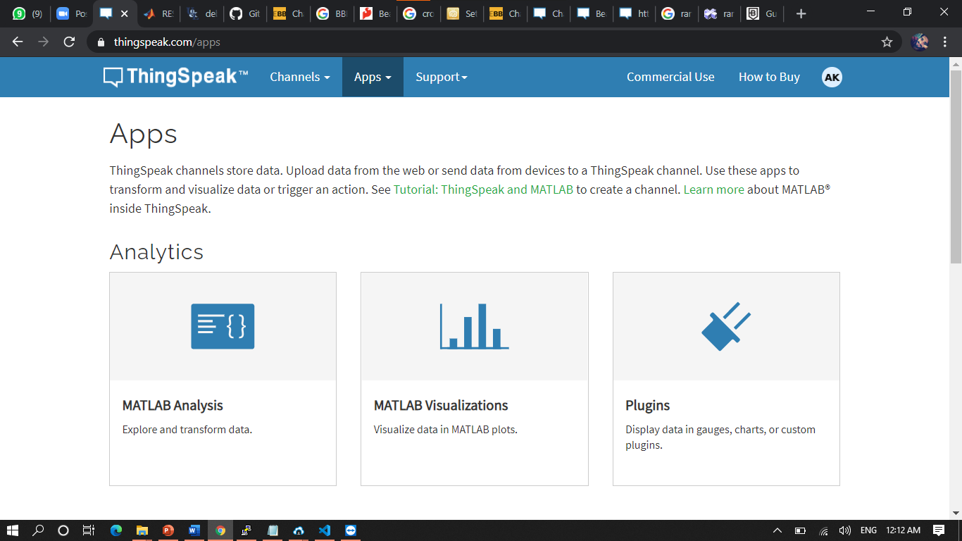

Slide 19
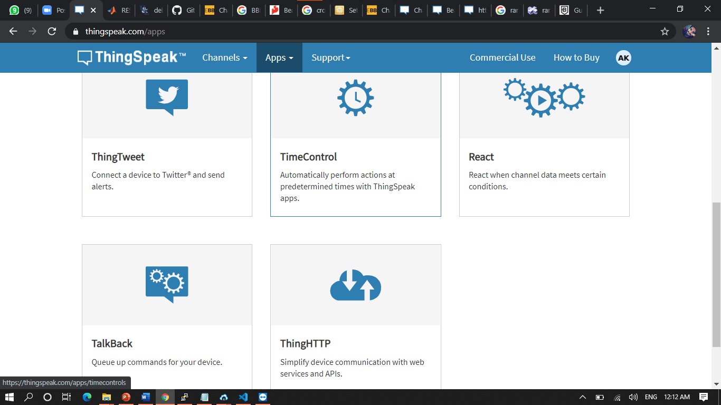

Slide 20
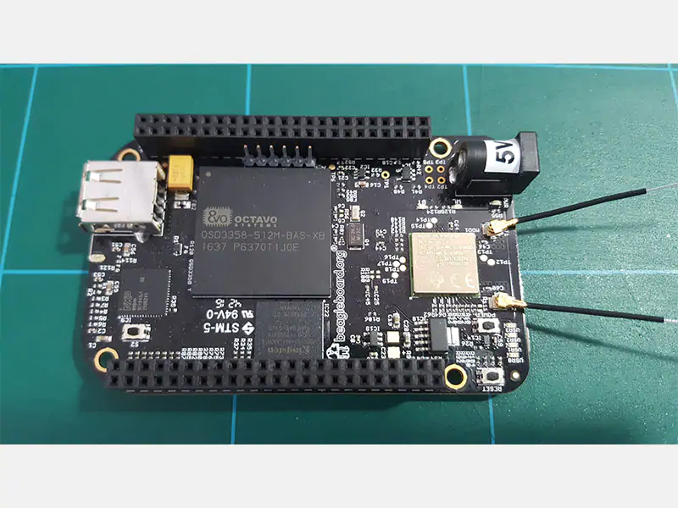
BBB wireless Wifi Module
The BeagleBone Black Wireless (BBBW) uses the same wireless chip as the BeagleBone Green Wireless (BBGW), which is the WL18MODGB TI module.
BBBW does not have a built-in antenna therefore solely relies on the provided external antennas.
This revision has also removed the Ethernet port and as such users will have to rely on the WiFi for Internet connectivity.

Slide 21
Setup wifi fo BBB wireless
ssh debian@192.168.7.2
sudo connmanctl
connmanctl> enable wifi
connmanctl> Services
connmanctl> agent on
connect wifi_xxxxxxxx_managed_psk
quit

Slide 22
Advantages of using Thingspeak
ThingSpeak allows you to aggregate, visualize and analyze live data streams in the cloud. Some of the key capabilities of ThingSpeak include the ability to:
Easily configure devices to send data to ThingSpeak using popular IoT protocols.
Visualize your sensor data in real-time.
Aggregate data on-demand from third-party sources.
Use the power of MATLAB to make sense of your IoT data.
Run your IoT analytics automatically based on schedules or events.
Prototype and build IoT systems without setting up servers or developing web software.
Automatically act on your data and communicate using third-party services like Twilio® or Twitter®.

Slide 23
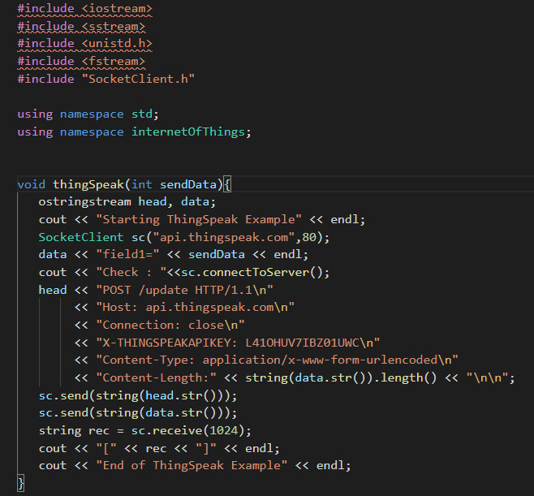

Slide 24
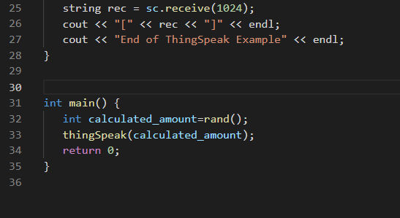

Slide 25
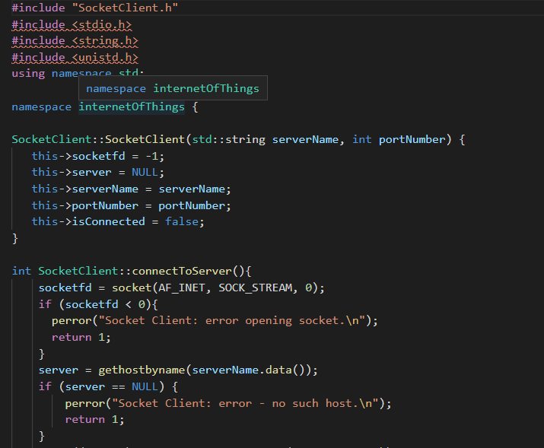

Slide 26
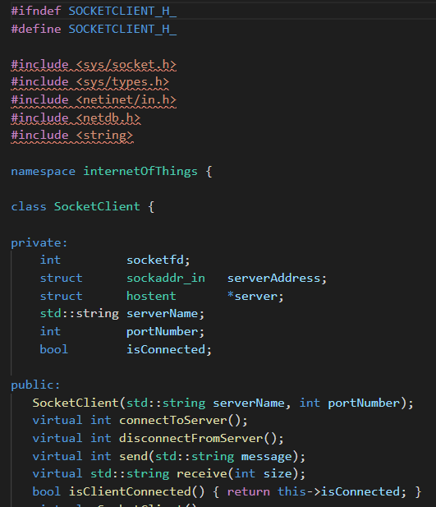
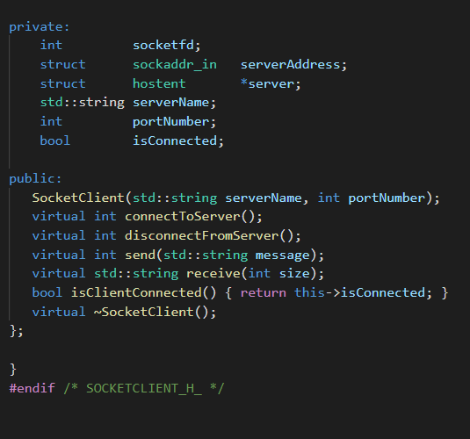

Slide 27
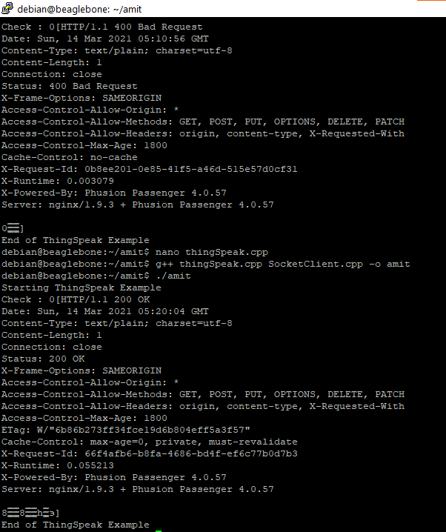

Slide 28
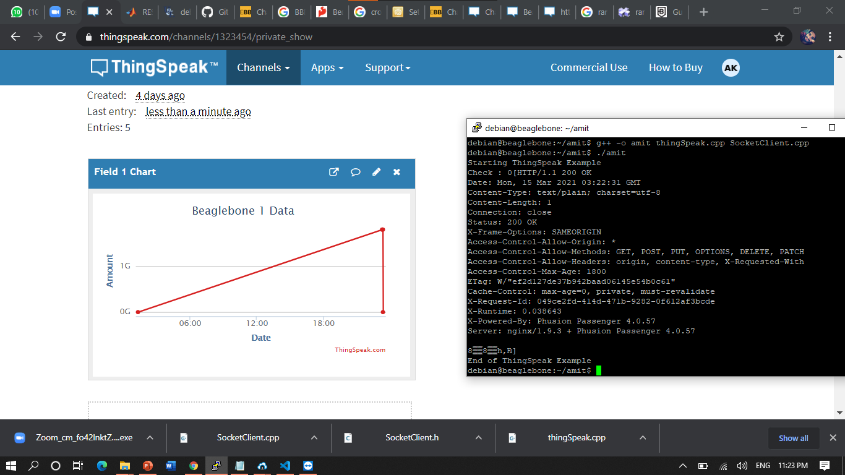

Slide 29
Limitation of thinkspeak!
Free users are limited to 10 million messages (3+ years at minimum update interval)
Paid users are limited to 100 million messages per unit (3+ years at minimum update interval)
If storage is exceeded, your channels may no longer be able to receive data.
Long term archiving of data for paid customers only.
We can only upload integer values on ThingSpeak.

Slide 30
References
Http information
https://en.wikipedia.org/wiki/Hypertext_Transfer_Protocol
MQTT information
https://en.wikipedia.org/wiki/MQTT
ThingSpeak information
https://thingspeak.com/pages/learn_more

Slide 31
References
Coding for ThingSpeak
http://exploringbeaglebone.com/chapter11/
link for ThingSpeak channel
https://thingspeak.com/channels

Slide 32

Questions? Thank YOU

